Slide 1

On-Call fraud Procedures
Churn Reduction and Retention Carol Trimmer and Rob Sutton 5/18/2010
Customer Care April Results & Accomplishments
Vonage Holdings Corp. Proprietary & Confidential

Slide 2
VoIP Fraud
VoIP fraud can be defined as the unauthorized use of paid communication services charged to someone who isn't expecting it, whether that is the service provider or the customer.
The fraudster looks for a vulnerable (usually publically available) VoIP device, once they have detected one they usually can acquire the SIP credentials for the device.
The Fraudster enters into an agreement with a local exchange telephone carriers in rural areas they then inflate the volume of incoming calls to their network, and make a percentage of the profit off the fees paid.

Slide 3
Types Of Alerts
Root Alert
These are rated calls that are being charged to the account or Vonage is being charged for the routing i.e. International. These alerts are triggered depending on the accounts threshold. They can either be triggered from 6+ calls in a minute, 8+ call in a minute 45+ calls in an hour, or 60+ calls in an hour.
Domestic Alert
This happens with concurrent calls to any of the 48 states that are not usually rated (Alaska & Hawaii) These are triggered in the same way that a root alert is triggered
Vonage Alert
This type of Alert happens when our carrier (TATA communications) has reason to suspect Fraud to a number or area. These Alerts will usually have the Caller ID of the Dialing number and the Caller ID of the Dialed number.
Spending Alert
This will happen when spending for that account exceeds the set limits of either $300 or $500 within a 24hr period. This usually involves more than one extension on the account.
Manual Alerts
These Alerts are not actually triggered but come down in email form usually from someone in the NOC department reporting unusual activity on an account. These calls, while not always Fraudulent, tend to be creating some type of server issues.

Slide 4
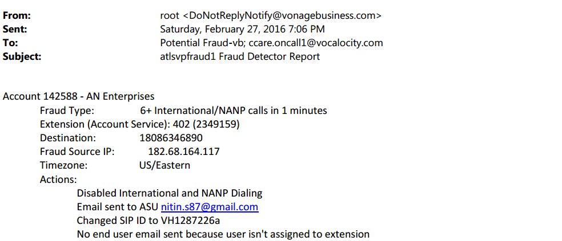
Root Alert

Slide 5
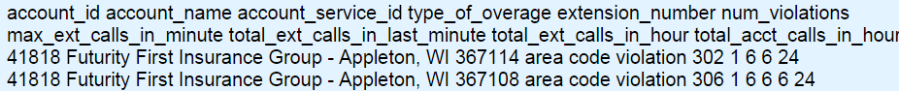
Domestic Alert

Slide 6
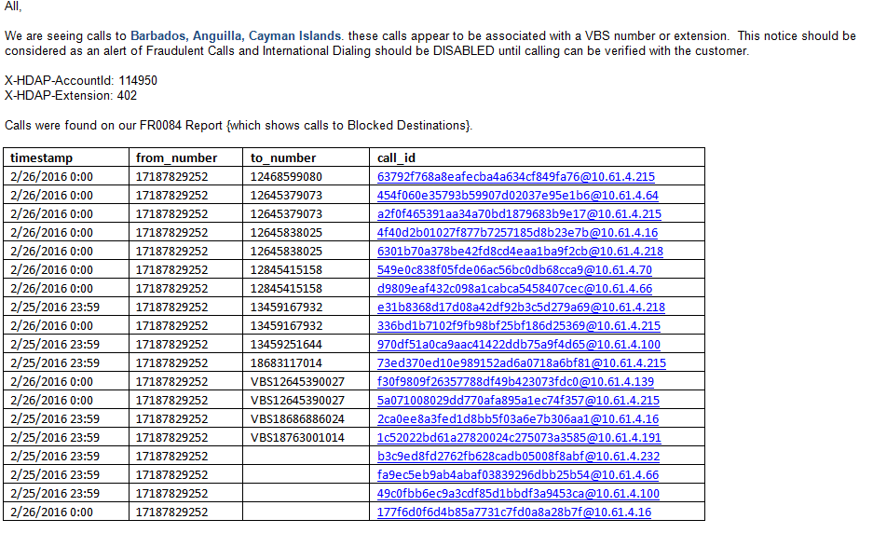
Vonage Alert

Slide 7
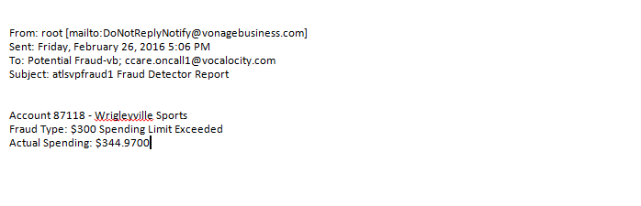
Spending Alert

Slide 8
Investigation Steps
After the Fraud alert comes to the On-Call phone forward that email to yourself in Outlook.
From Outlook “Reply All” (Potential Fraud & CCare On-Call 1) with “Investigating”. Make sure your reply includes your Outlook signature.
Check the Account and see if a ticket was created in Salesforce if not create one. Insure you change case owner to On-Call and place your name in the Tier 2 Rep field.
Copy the notes from the Alert and paste them into the Salesforce Description, be sure to include the type of Fraud Alert i.e.: Root, Domestic, Vonage, or Spending.
Thoroughly investigate the potential Fraud and make your determination whether it’s a False-Positive or Fraud.
From Outlook “Reply All” to the Alert with your investigation notes. (see examples below)
Update your salesforce ticket with your investigation notes in the “Log Call” section change Problem Codes to reflect False-Positive or Fraud. Make sure case owner is set to On-Call and your name is in the Tier 2 Rep field or you will not be paid.
Close Ticket “Resolved”
Advise the Fraud team of any actual Frauds the next day so the total charges can be calculated.

Slide 9
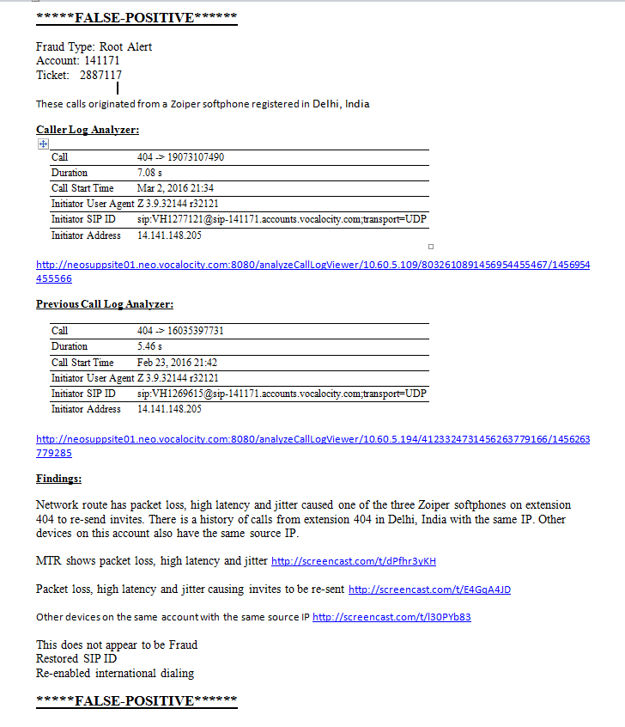
Fraud Template Example
Change the Fraud Type according to the alert you receive, i.e. Root, Domestic, Vonage, or Spending
Make sure your previous call example is at least 2 weeks prior to the current date
Provide adequate explanation and supporting screenshots within the findings section
This template can also be used for investigations that you determine to be Fraud.
Using this template ensures that you have gathered sufficient data and are more likely to identify investigations correctly.
**Please note: if you do not use this template and the information you provide is not adequate we will take ownership of your on call case to do a proper investigation. This mean you will not get paid for that case.

Slide 10
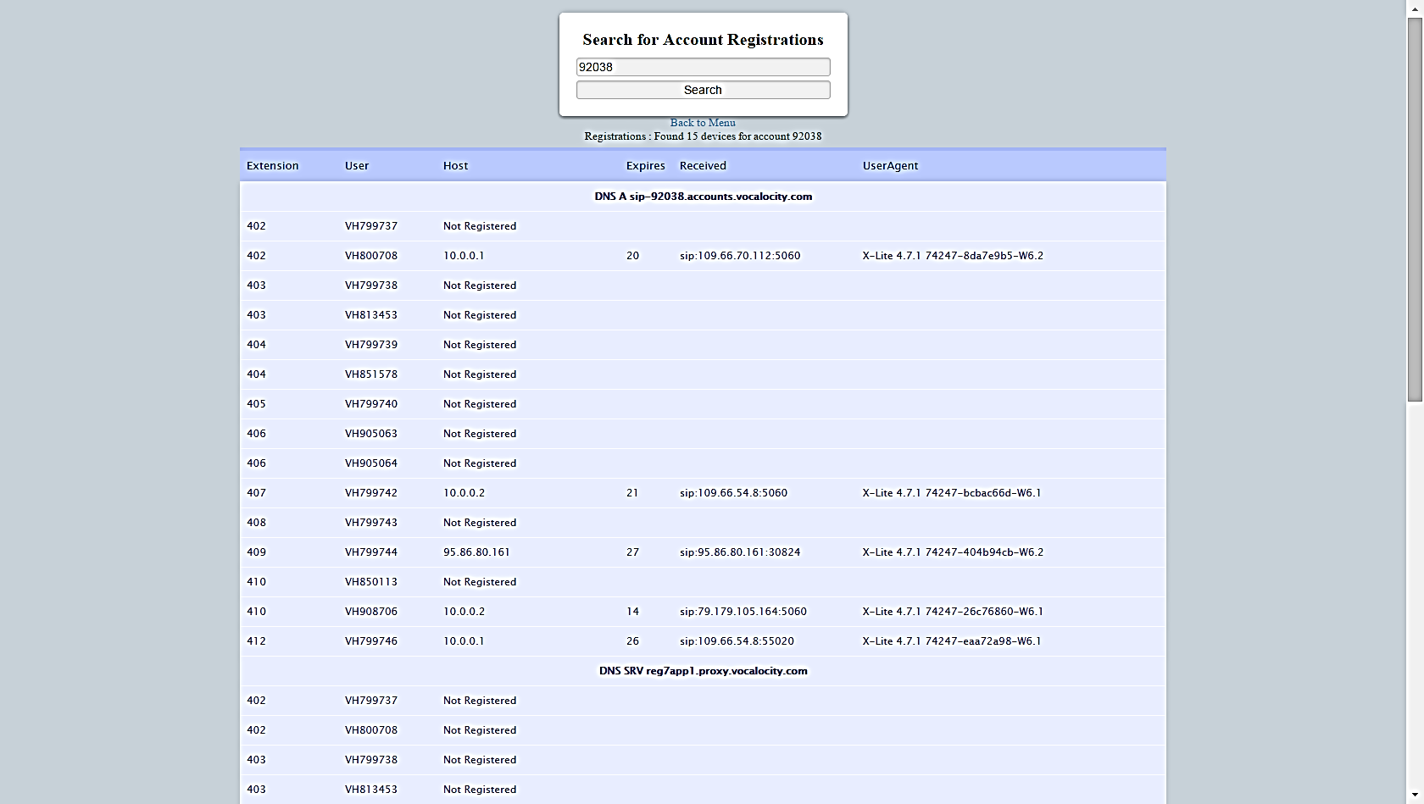
Begin Your Investigation
You will begin you investigation by looking at the account registration page.
From here you will want to check the IP addresses of any currently registering devices.
You will also want to see if there are any devices registering with duplicate IP address.

Slide 11
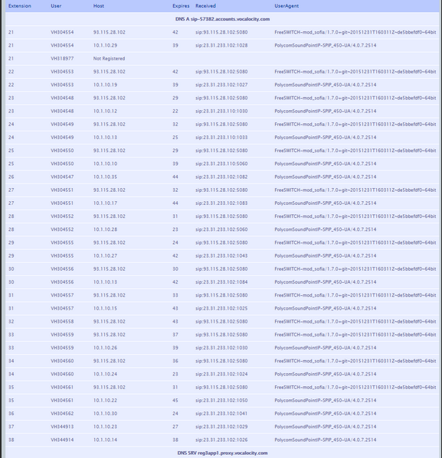
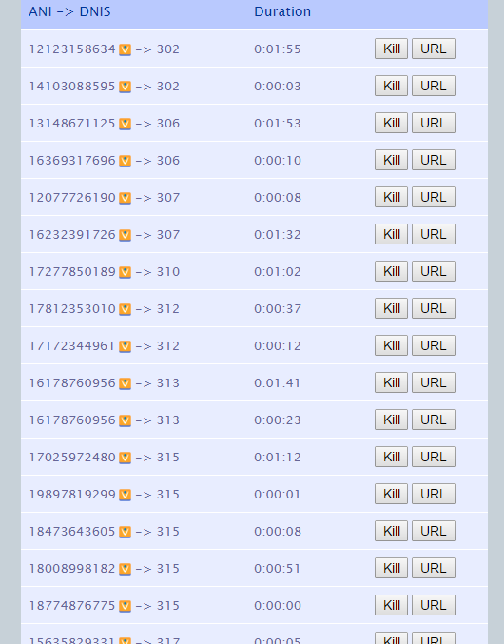
Begin Your Investigation Continued …
Check if there are any suspicious devices registered or duplicate SIP IDs.
Use call killer to kill any active calls to the suspected Fraudulent numbers

Slide 12
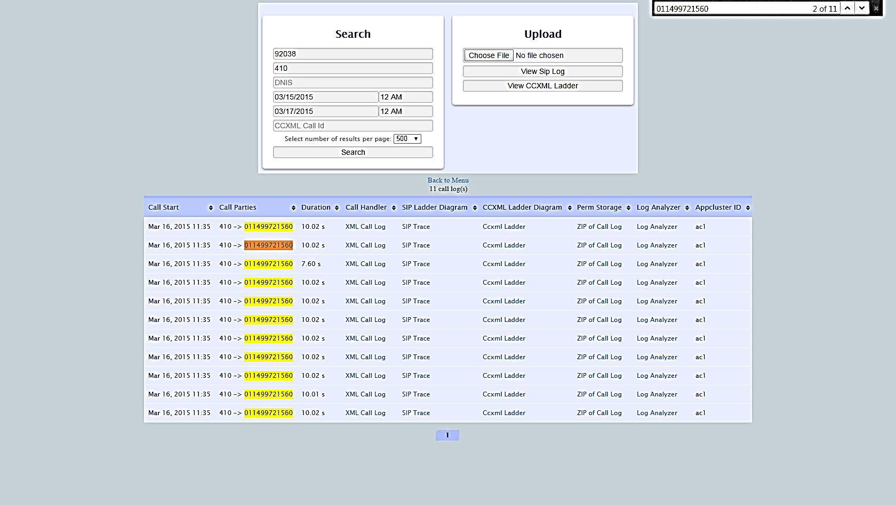
Investigation continued …
Next you will need to bring up the call logs of the extension that set off the Alert.
Search the call logs for the destination number or the terminating number.
Pay close attention to the amount of times the same number was called and the duration of those calls.

Slide 13
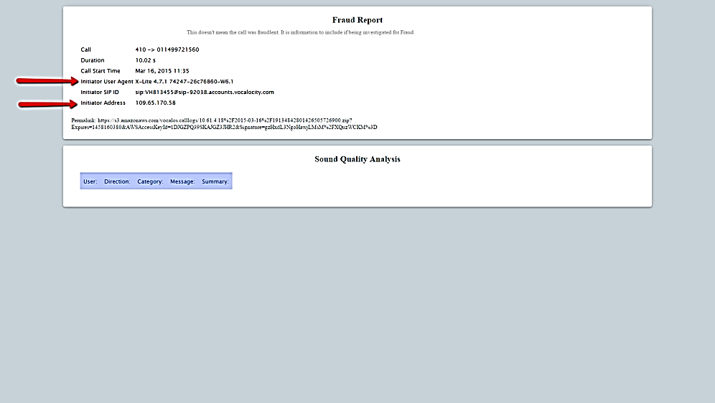
Investigation continued …
Your next step is to bring up the log analyzer for the last call
The Information you will need from here will be the Initiator User Agent which will tell you the device that place the calls, and the Initiator Address which will tell you from where the device was when the calls were placed
Make sure this information is copied and pasted as per the Fraud Template

Slide 14
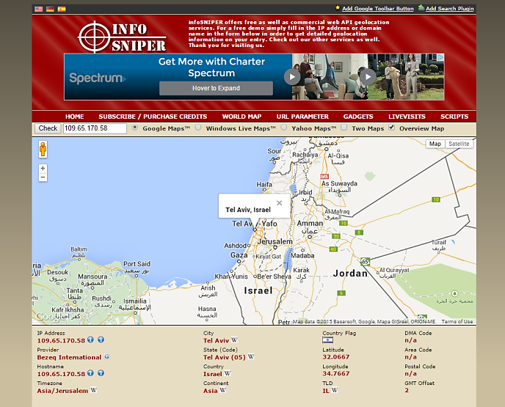
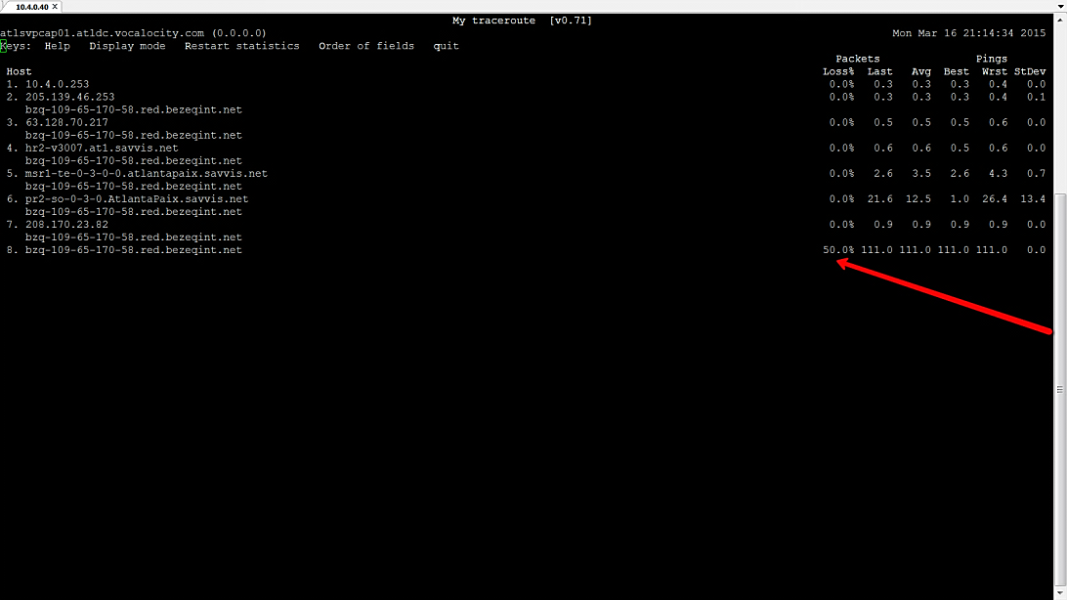
Investigation continued …
Use a IP address look up tool (like infosniper.net) to look up the IP address of the Initiator User Agent pay close attention to where these calls were place from.
You will also want to run an MTR to the Initiator User Agent IP address . Look for any signs of High latency, Jitter, or Packet Loss.

Slide 15
Investigation Results
These Same Investigation steps can be used to investigate any Alert that you may receive. Though a Carrier Alert or a Manual Alert may require further investigation. A Carrier Alert may not have completed calls or sometimes may not have the account number
What you will need to do in some cases is look up the calling number in HDAP on the Call Block page.
Once you are able to identify the account check the call history with support tools and determine if this looks like normal or out of the normal activity for this account. i.e. does this account have a history of making calls to the reported area.
You can also attempt to reach out to someone on the account to verify.
With a Manual Alert while the calls may be legitimate you may need to determine if the account is doing anything that is against our Terms of Service. i.e. forwarding calls through the system causing stress on the servers

Slide 16
Investigation continued …
You will now want to look at the call logs again. This time look at calls made at least 2 weeks back from the same extension.
You will once again bring up the Log Analyzer from one of these earlier calls.
Compare the information here to the information from the Log Analyzer that set off the Alert.
Check to see if these calls were from a different device, at a different IP address.
If the Device and IP address are the same and there was high latency, jitter, or packet loss this more than likely is a False Positive Alert.
If the Device is different and the location of the IP addresses are far and seem to be suspicious then this could potentially be a Fraud.

Slide 17
Other ways to investigate.
If after your research you are unclear whether the calls were Fraudulent or not.
You can attempt to call the Account Super User to verify.
You can attempt to place a call to the user on the extension.
If the calls were international check the account to see if there is a history of making these types of calls.
Reach out to your Supervisor or a Fraud SME.

Slide 18
Helpful Tools
trackandtrace.com/country-codes.html - Provides a long list of countries and corresponding country codes
411.com, whitepages.com, fonefinder.net – phone number lookup
Whois.domaintools.com
dnsstuff.com/tools – one stop site for a host of tools

